Slide 1


Social
Buzz

Slide 2


Today's agenda
1. Project recap
2. Problem
3. The analytics team
4. Process
5. Insights
6. Recommendations

Slide 3

Social Buzz is a fast-growing technology platform that provides various categories of content from anonymous users, that need help to adapt quickly and effectively to its global scale.
Accenture has carried out 3 months in this project focusing on these task:
An audit of their big data practice
Recommendations for a successful IPO
An analysis of their content categories that highlights the top 5 categories with the largest aggregate popularity
Project Recap

Slide 4

Problem
Over the past 5 years, Social Buzz has reached over 500 million active users each month.
Over 100,000 contents per day are posted!
36,500,000 contents per year!
But how to capitalized on it when there is so much?
An analysis to find Social Buzz top 5 categories of content based on their popularity!

Slide 5



ANDREW FLEMING
Chief Technology Architect
The Analytics team
MARCUS ROMPTON
Senior Principal
TITO DWI SYAHPUTRA
Data Analyst

Slide 6
Process
1
Data Understanding
2
Data Cleaning
3
Data Modeling
4
Uncover Insights
5
Recommendations

Slide 7

Insights
16
UNIQUE CONTENT
CATEGORIES
69
TOTAL POSTS TO “ANIMAL” CONTENT
1,897
TOTAL REACTIONS TO “ANIMAL” CONTENT
74,965
TOTAL SCORE TO “ANIMAL” CONTENT

Slide 8
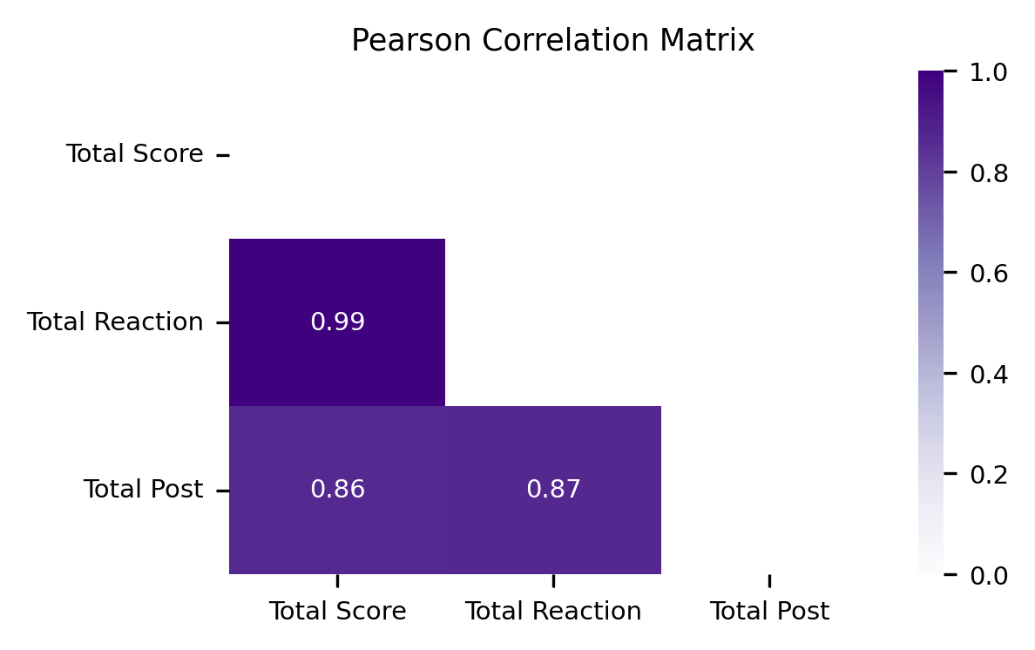
Strong correlation are found between pairwise of Total Score, Total Reaction, Total Content. (corr > 0.86), meaning that the greater the number of either Reactions or Contents, the greater the Popularity Scores
This situation is relevant with the data since the quantification of Popularity Scores uses only positive values even though there are negative sentiments.

Slide 9
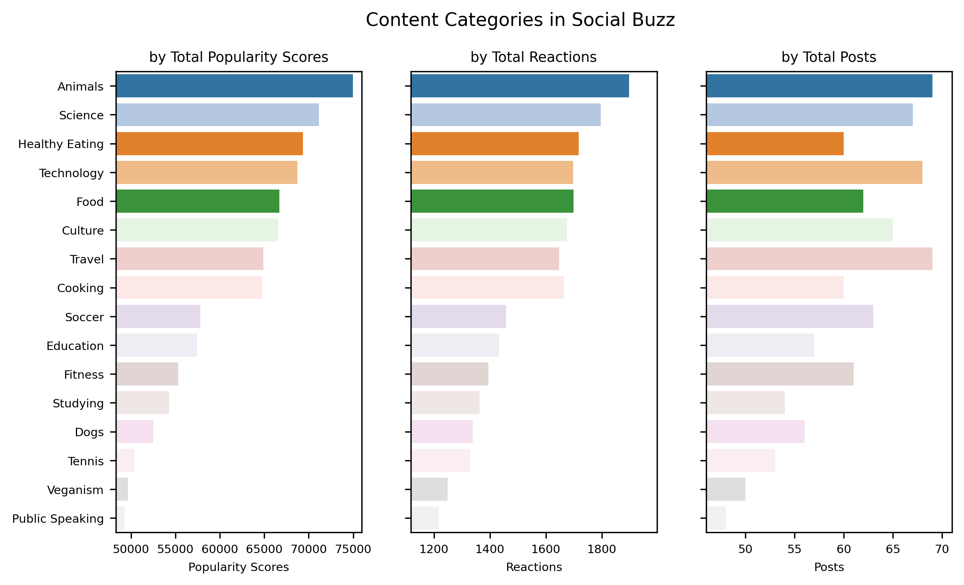
Top 5 categories by popularity are Animals, Science, Healthy Eating, Technology, and Food.
Animals and Science (followed by Technology also) are included in the two most popular categories showing that users on Social Buzz enjoy “real-life” and “factual” content the most.
Food is also in the top 5 categories especially for Healthy Eating ranking the highest.

Slide 10
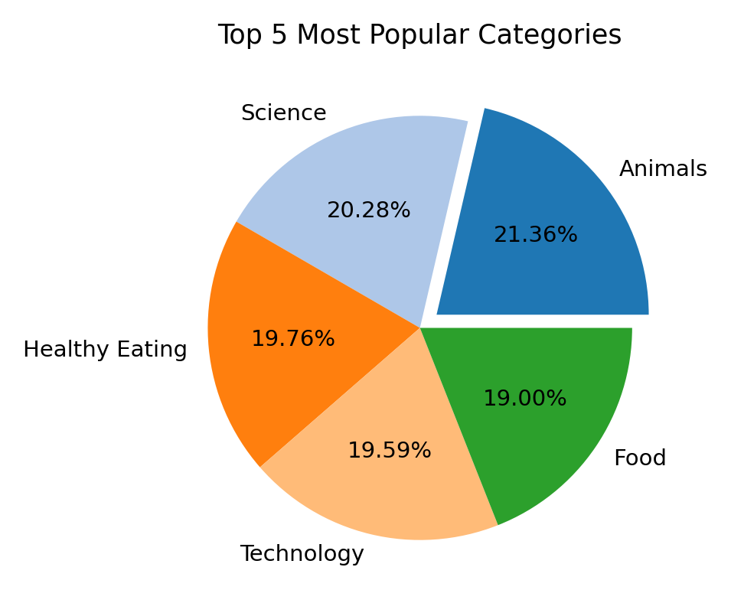
There is not much difference between the proportion of each category, however, the difference between the 1st most popular Animals and the 2nd most popular Science has the largest gap equal to 1.18%.
This might suggest that the Animals content would be tailing away even further, and getting more and more popular from the rest of content categories.
Social Buzz needs an algorithm to ensure that there is a fair balance between categories in order to avoid an issue where 1 content category consumes the entire platform.

Slide 11
Recommendations
For Healthy Eating Content:
Create a campaign and work with “Healthy Eating” brands to boost user engagements.
For Animal Content:
Organize an animal contest. For example, ask your users
to share their pet photos with a specific theme,
to share heartwarming and touching stories about animals,
to educate audiences with interesting facts, behavior insights, and care tips for various animals.
For Science Content:
Create debates and discussions forums. For example ask questions or topics related to science and encourage the audiences to participate in debates and discussions in the comments section.
For Technology Content:
Organize a contest about posting the latest and cutting-end information of technology.

Slide 12
Thank you!

